Slide 1
LENDING CLUB CASE STUDY - Exploratory Data Analysis
Name : - Sumit Suryanarayan Patro
Email ID : - patrosumit33@gmail.com
Contact Number : - +91 8779487231

Slide 2
OBJECTIVES : -
Through Exploratory Data Analysis, we aim to display patterns and insights within the dataset to distinguish characteristics associated with loan defaulters. By analysing the data completely, we seek to disclose key factors influencing borrower behaviour providing the lending company with actionable information to make informed decisions in risk assessment.
This investigation involves through into various features such as applicant information, financial indicators, and loan terms to identify correlations and trends that can be indicative of potential defaults. The ultimate goals is to empower the lending company with predictive knowledge, enabling them to implement targeted strategies and mitigate financial losses by avoiding loans to high-risk individuals.
By leveraging EDA techniques, we intend to uncover nice patterns, relationships, and outliers within the dataset, shedding light on the factors that significantly contribute to loan default. This proactive approach allows the lending company to refine its credit approval process, strengthen risk management protocols, and enhance overall decision-making when extending loans.

Slide 3
PROVING SOLVING PLAN : -
Importing Required Libraries & Loading Data
Data Understanding
Data Cleaning
Data Formatting
Univariate Analysis
Unordered Categorical Variable Analysis
Ordered Categorical Variable Analysis
Derived Variable Analysis
Bivariate Analysis
Correlation Analysis

Slide 4
Importing Required Libraries & Loading Data: -
numpy as np
pandas as pd
matplotlib.pyplot as plt
seaborn as sns
Data Understanding: -
Total Number of Rows 39717
Total Number of Columns 111
Types of Data are float, int and object

Slide 5
DATA CLEANING: -
Removed all the null values columns.
Removed all the single value columns.
Removed unique values columns [‘id’ and ‘url’].
Removed the text and description values columns.
Removed ‘subgrade’ column as we are limiting our analysis till grade level.
Removed Behavioural Columns also.
Removed the columns which is having more than 60% of null values which are not in use in our analysis.
We have removed the records whose loan status is current ['loan_status' with 'Current' is in progress and cannot rectify if the loan is going bad or not.].
We have gone through all the column and formatted our data as per our need.
We have renamed the columns for better understanding while plotting.

Slide 6
DATA FORMATTING: -
loan_amnt: - We have converted the datatypes from int to float for better EDA.
funded_amnt: - We have converted the datatypes from int to float for better EDA.
term: - While checking in dataset we have observed string part [months]. Hence, we have removed.
int_rate: - While analysing the dataset we have observed string part [%]. Hence, we have removed.

Slide 7

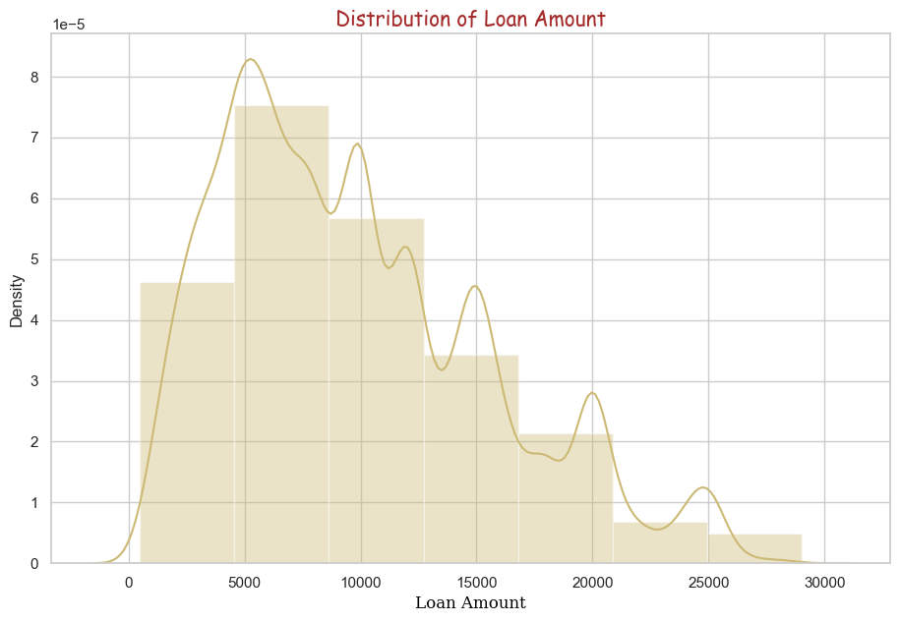



UNIVARIATE ANALYSIS
It has been observed that maximum number of Loan Amount is in between 5000 to 13000.

Slide 8
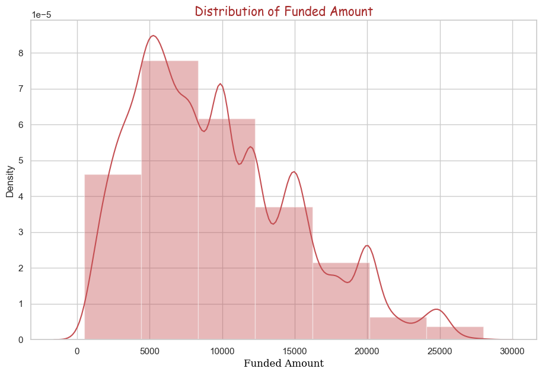
It has been observed that maximum number of Funded Amount is in between 5000 to 12000.

Slide 9
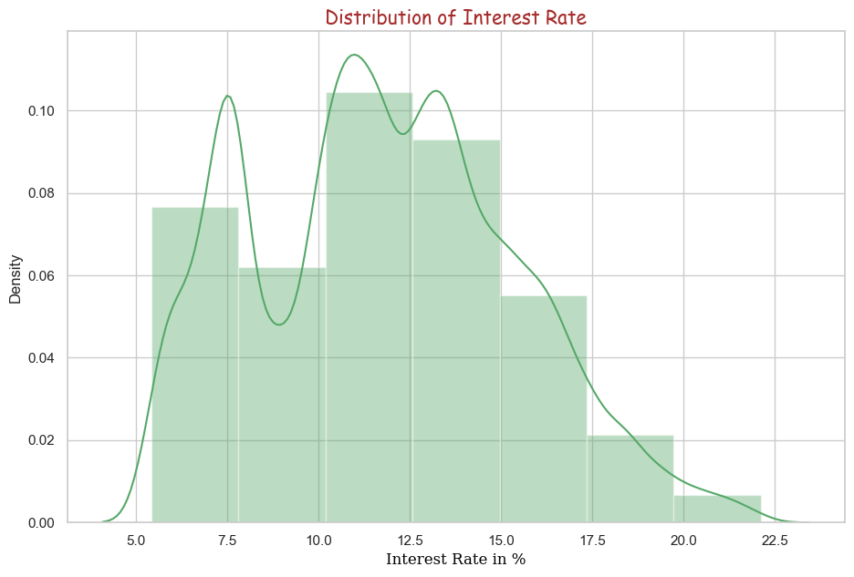
It has been observed that maximum number of Interest Rate is in between 5% to 15%.

Slide 10
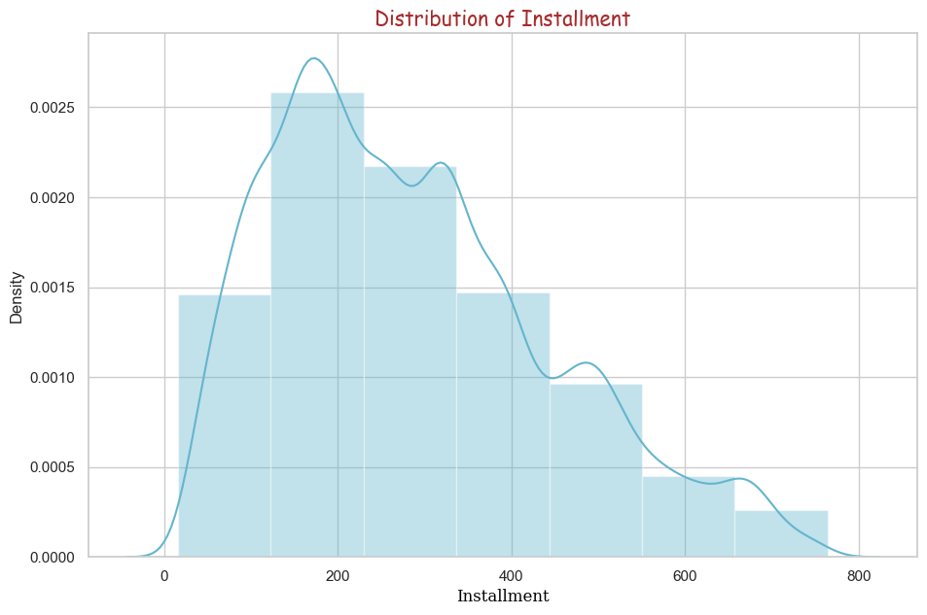
It has been observed that maximum number of Installment amount is in between 20 to 400.

Slide 11
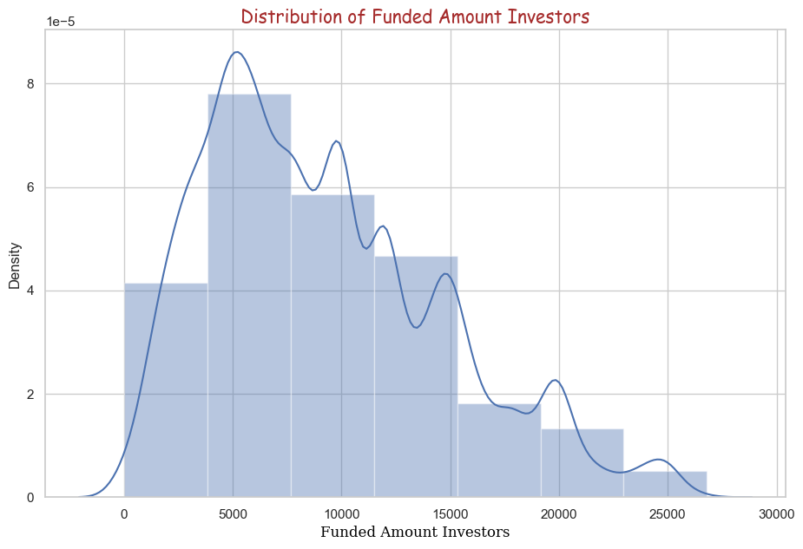
It has been observed that maximum number of Funded Amount Investors is in between 5000 to 11000.

Slide 12
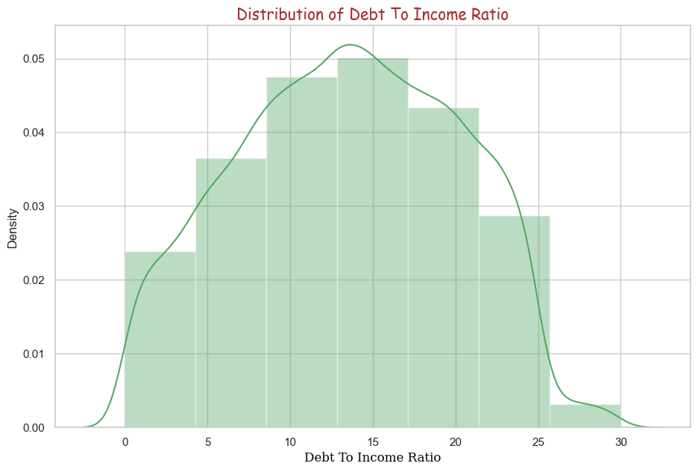
It has been observed that maximum number of Debt To Income Ratio amount is in between 5 to 22.

Slide 13

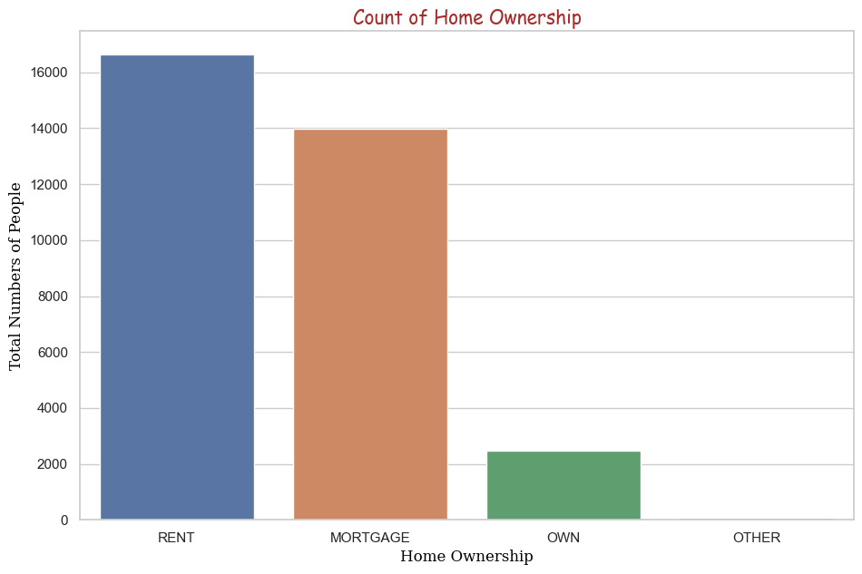
UNORDERED CATEGORICAL VARIABLE ANALYSIS
Rent and Mortgage exhibit the highest among Home Owner Status Categories

Slide 14
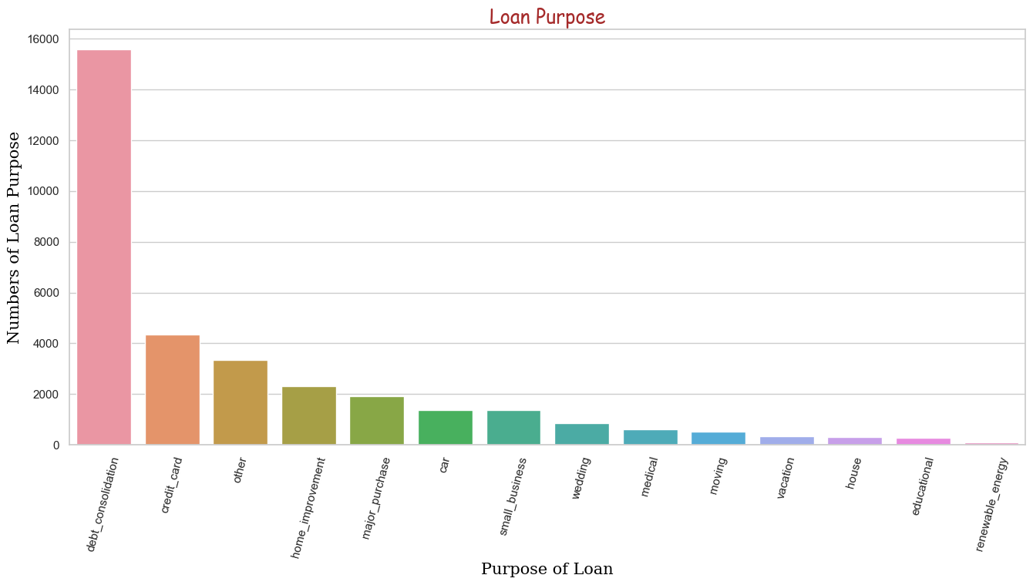
Majority of loan application are in the category of debt_consolidation.

Slide 15
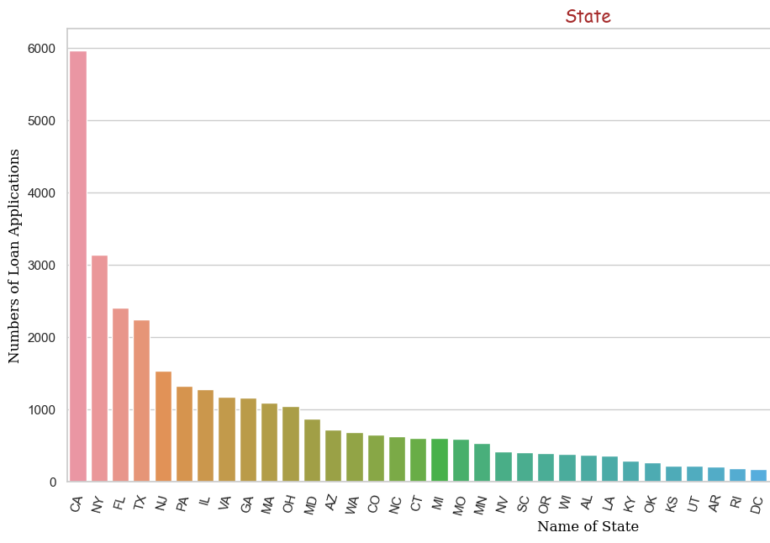
CA state has the highest number count of loan applications

Slide 16
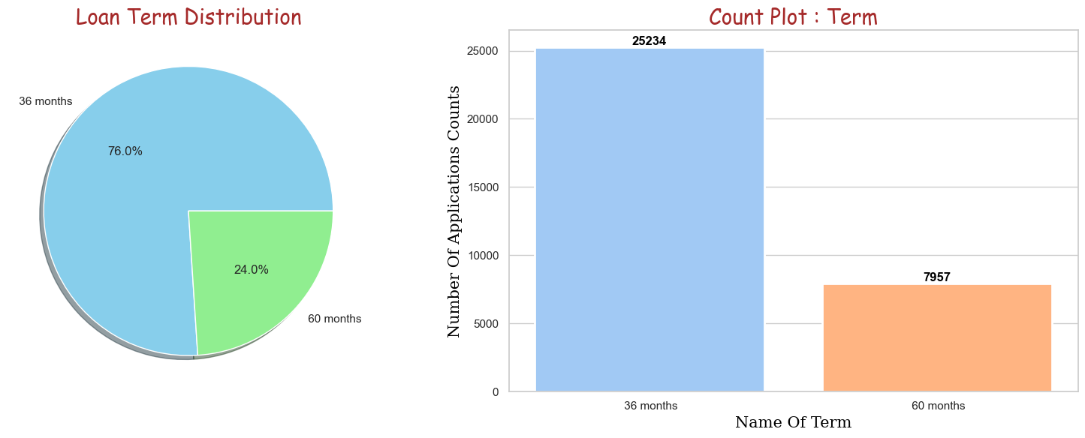
ORDERED CATEGORICAL VARIABLE ANALYSIS
76.0 % of loan applications counts are in term 36 months and 25234 applications count.
24.0 % of loan applications counts are in term 60 months and 7957 applications count.

Slide 17
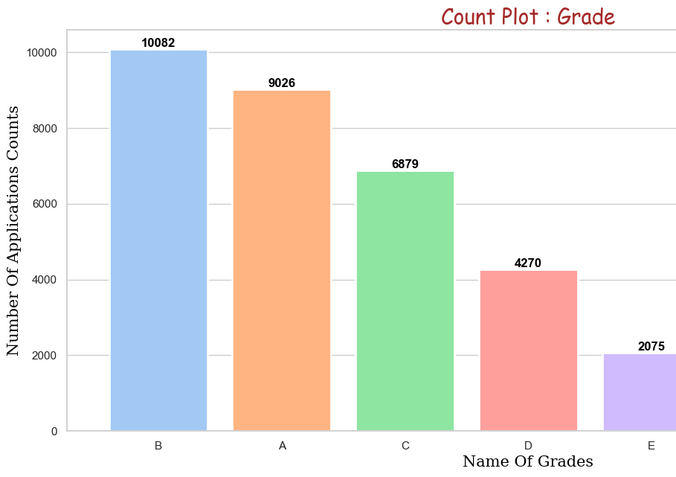
Grade B has the highest number of loan application count - 10082.
Grade G has the lowest number of loan application count - 159.

Slide 18
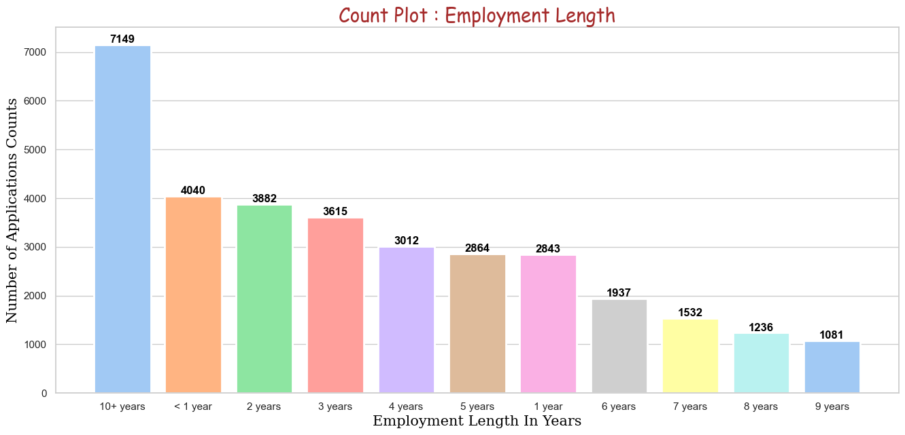
10+ years of employment length has the highest number of applications count with 7149 numbers.
9 years of employment length has the lowest number of applications count with 1081 numbers.

Slide 19
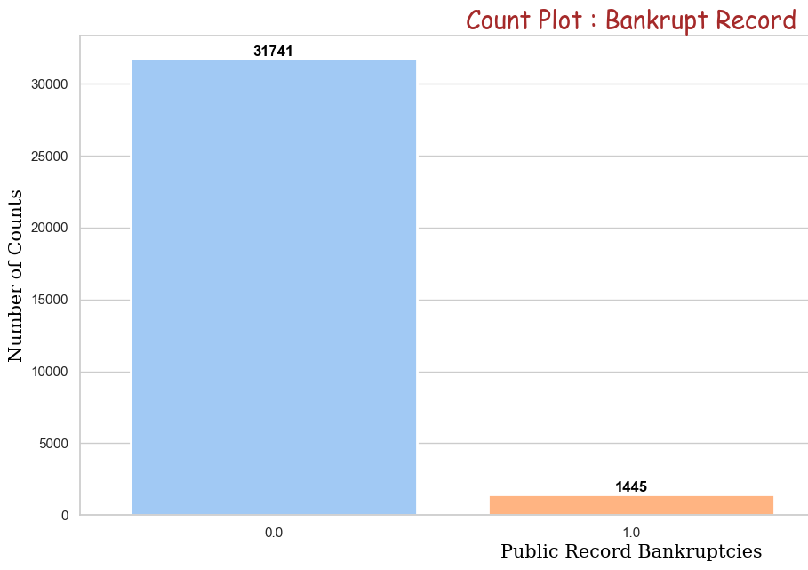
31741 customer out of 33191 does not have any bankrupt records.

Slide 20
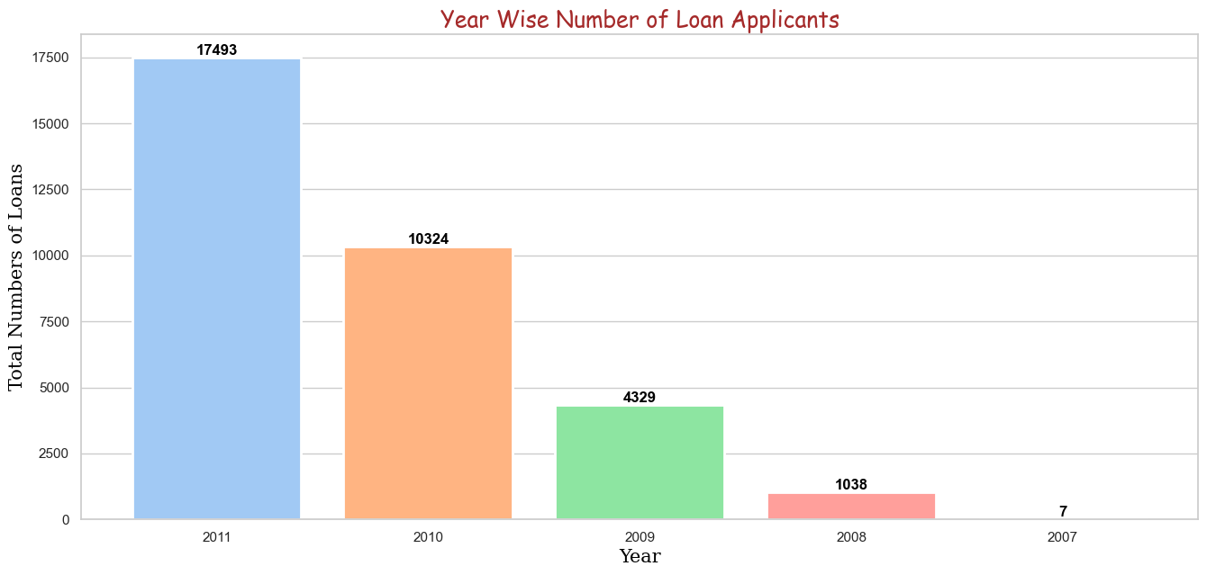
Loan application counts are increasing year over year. Maybe the risk exposure is increasing over the year

Slide 21
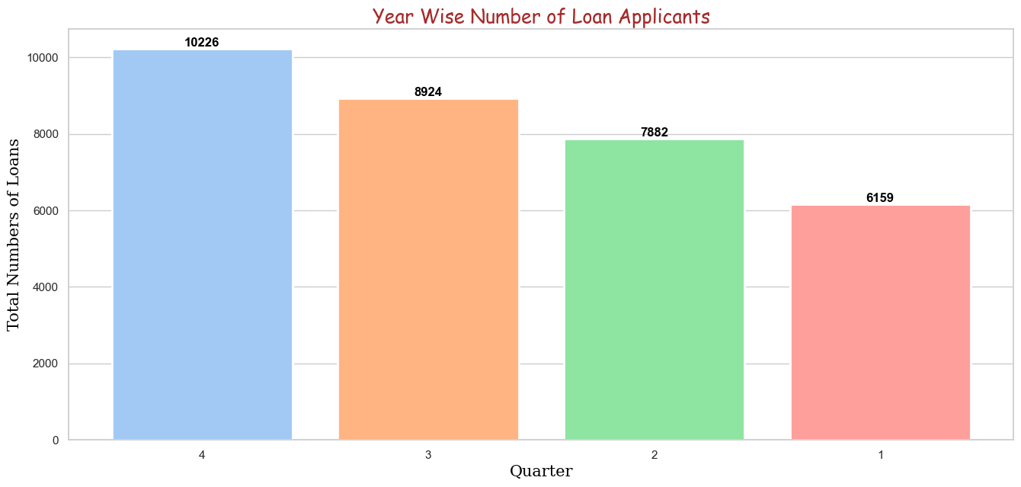
Highest Counts are in 4th Quarter which is 17493.

Slide 22
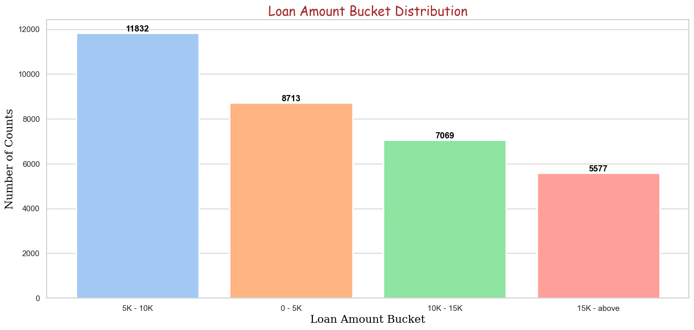
Loan Amount applications falls in the range of 5K to 10K.
11832 which most as compared to other.

Slide 23
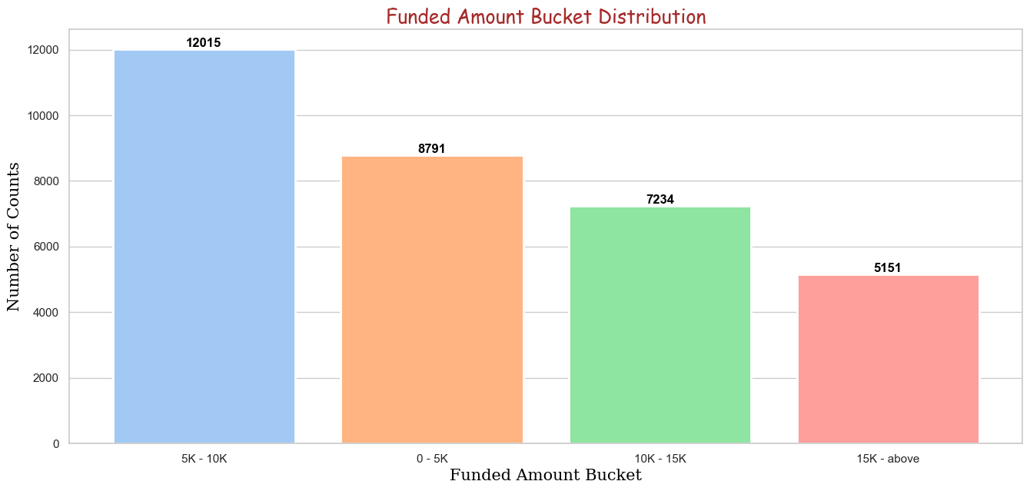
Funded Amount Bucket applications falls in the range of 5K to 10K.
12015 which most as compared to other.

Slide 24
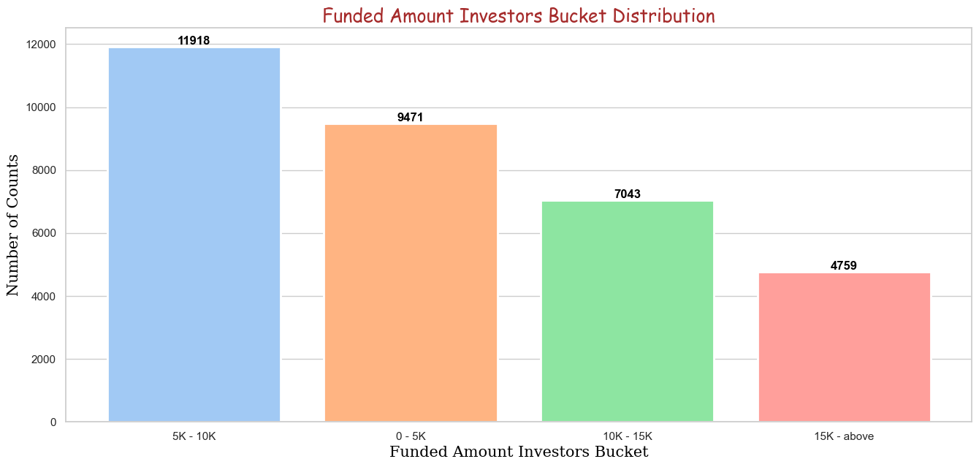
Funded Amount Investors Bucket applications falls in the range of 5K to 10K.
11918 which most as compared to other.

Slide 25
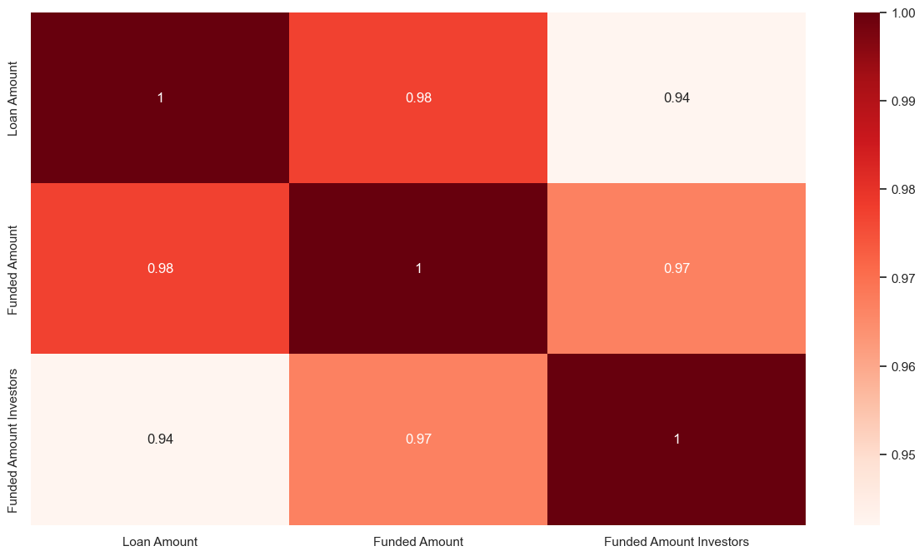
The Correlation shows that the Loan Amount, Funded Amount, Funded Investors Amount are highly correlated.

Slide 26
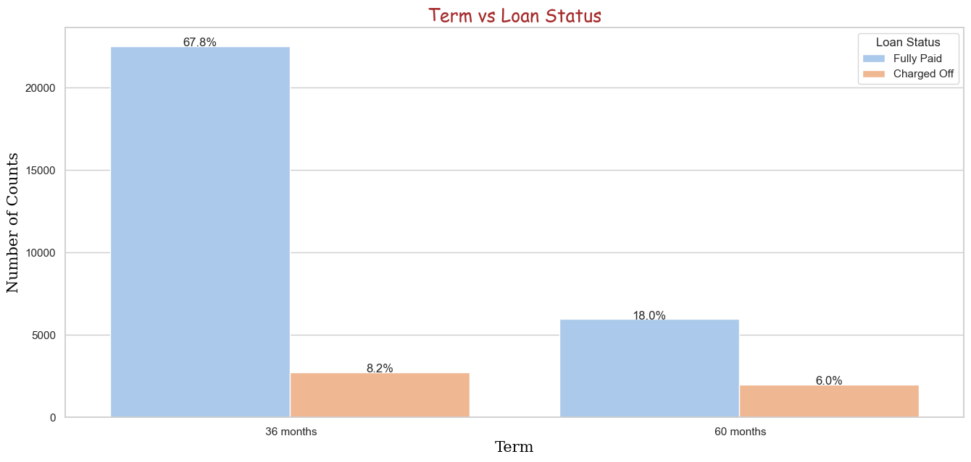
BIVARIATE ANALYSIS
Overall percentage of36 months Charged Off is bit higher then 60 months
36 months which charged off is 8.2% as compared to 60 months 6.0.

Slide 27
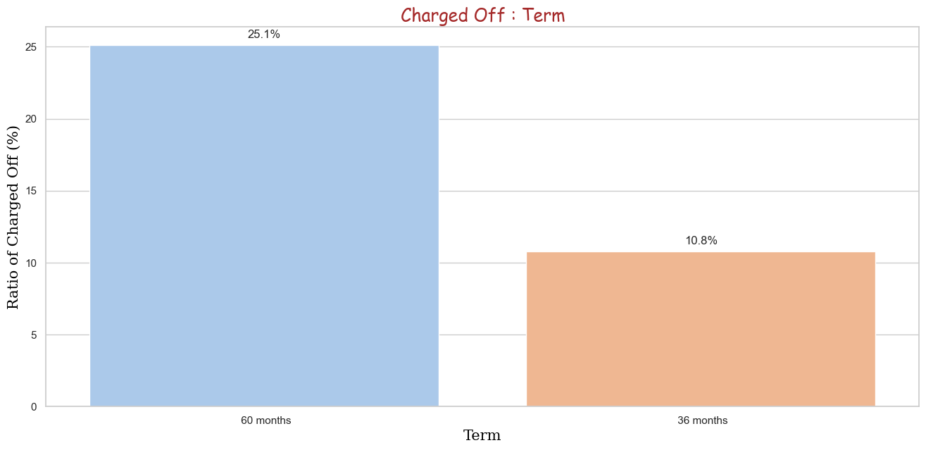
Charged Off ratio of 60 months [25.1%] which is higher than 36 months [10.8%]

Slide 28
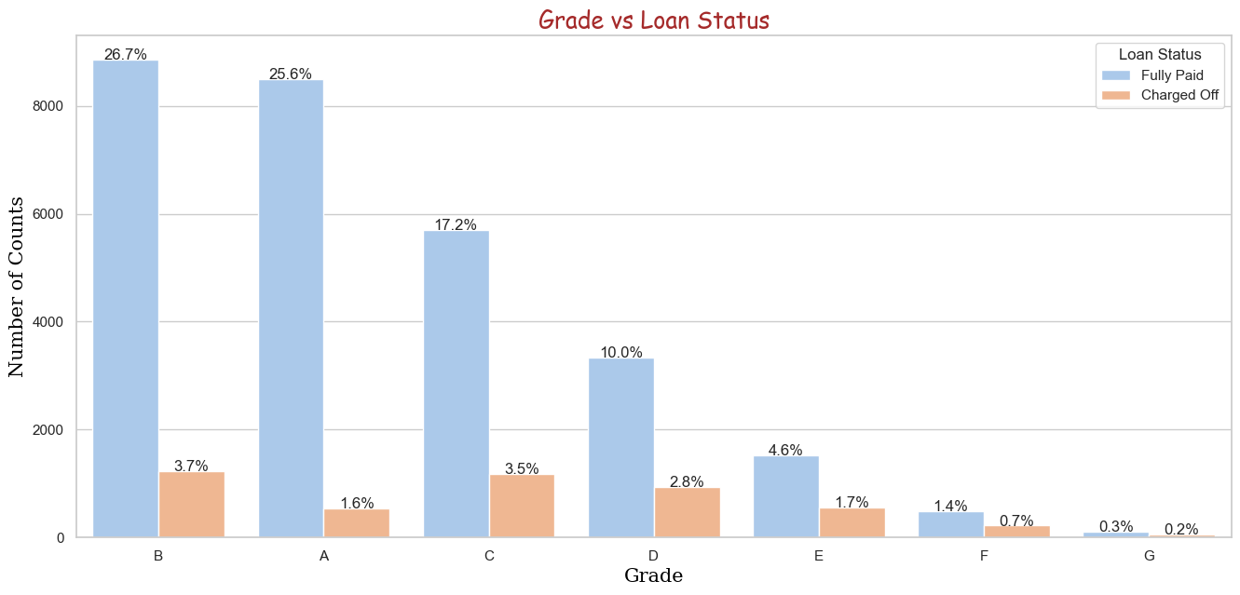
The maximum number of loan is in Grade B.
Highest Percentage of overall Charged Off are in Grade B [3.7%] and Grade C [3.6%]

Slide 29
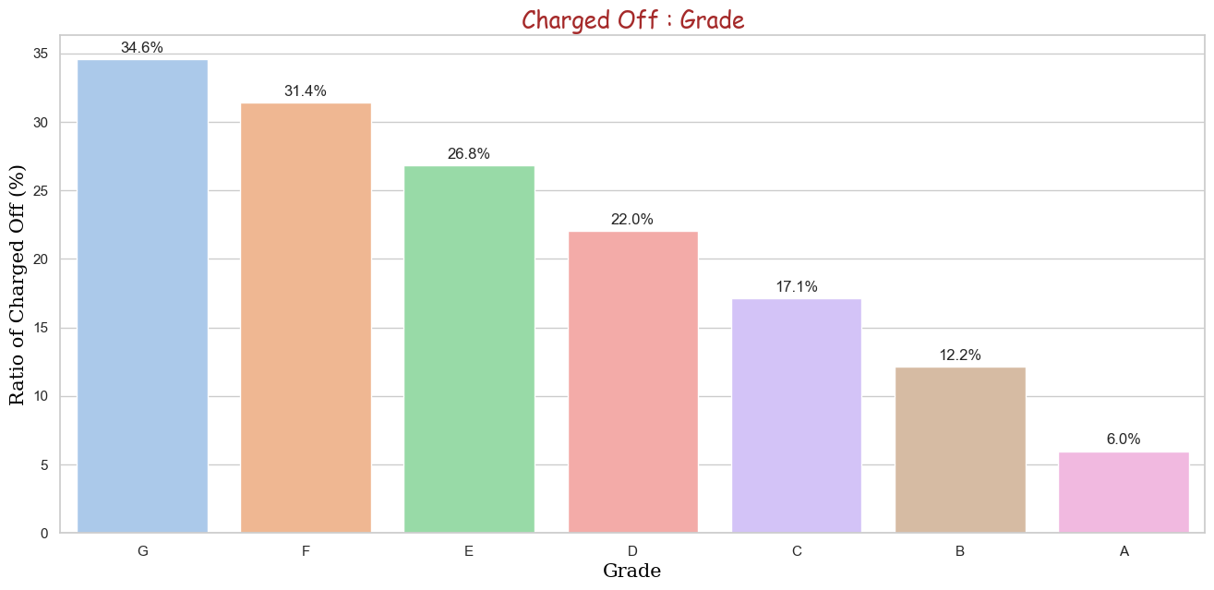
The highest percent of Charged Off is in the Grade G.
Probability of Charged Off is consistently increasing from A to G.
High chances of Charged Off is in Grade F and Grade G.

Slide 30
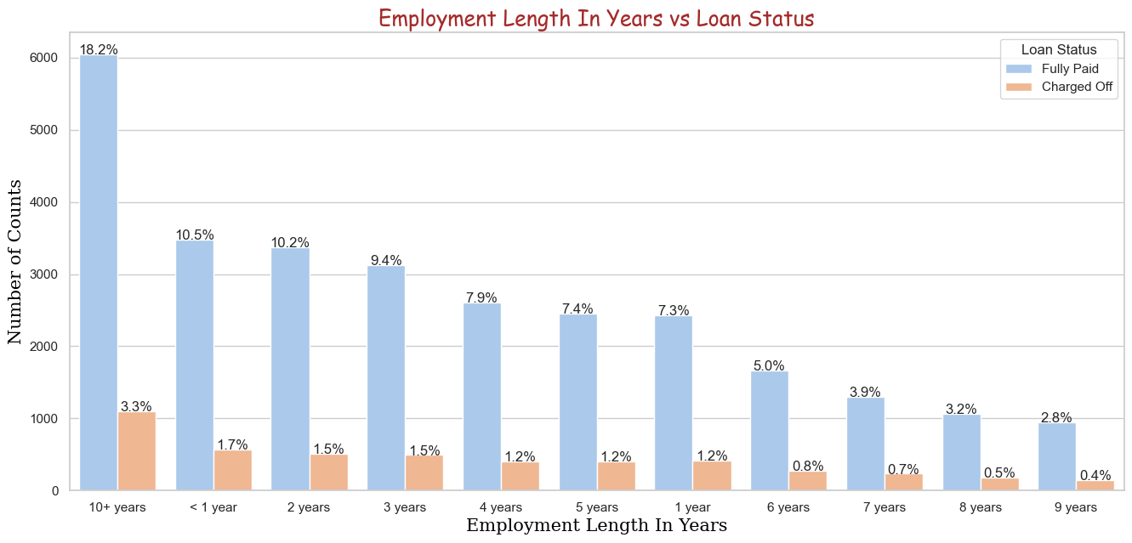
Maximum number of Charged Off are in 10 Years or above.
Least number of Charged Off are in 9 Years.

Slide 31
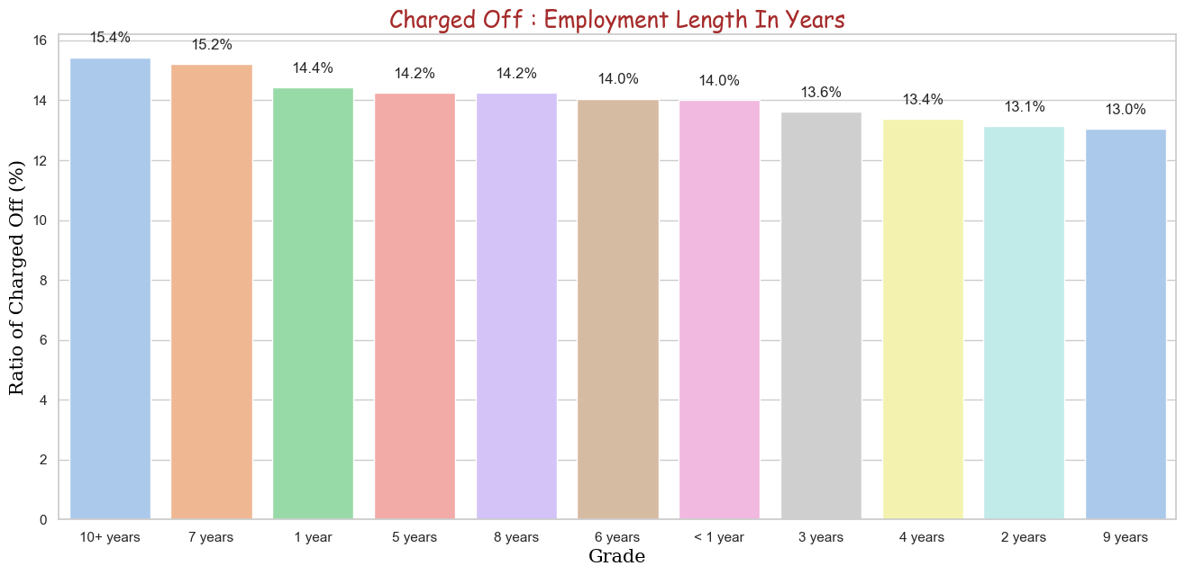
Maximum number of Charged Off are in 10 Years or above.
Least number of Charged Off are in 9 Years.

Slide 32
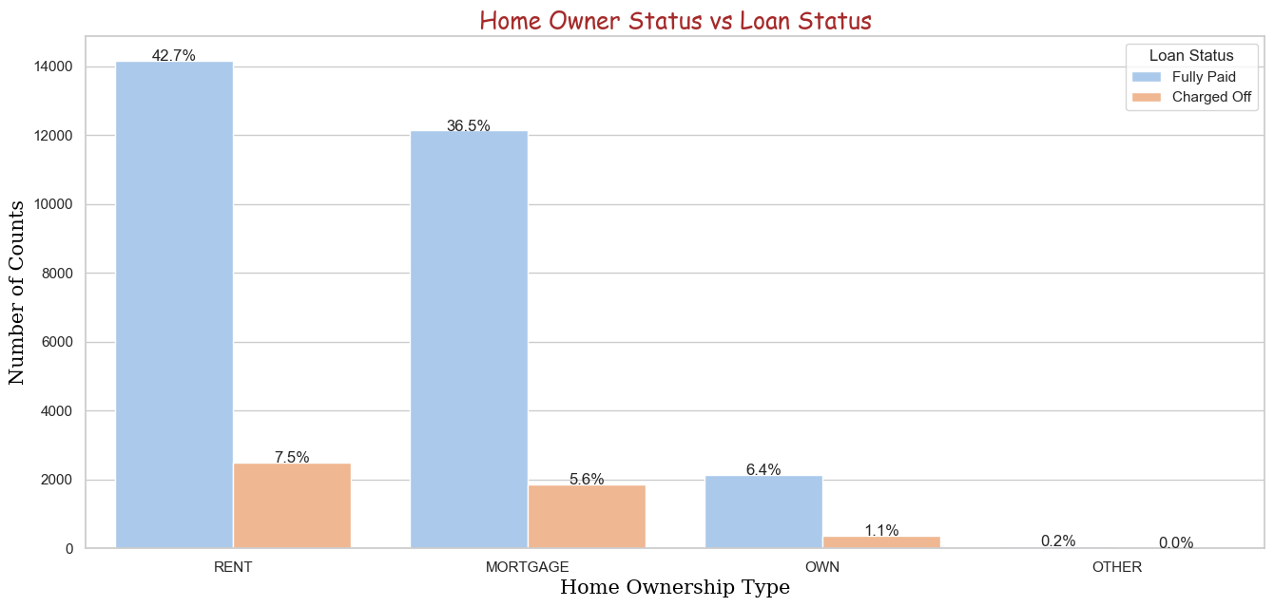
Overall highest number of Charged Off are in the RENT and MORTGAGE with 42.7% and 36.5% respectively

Slide 33
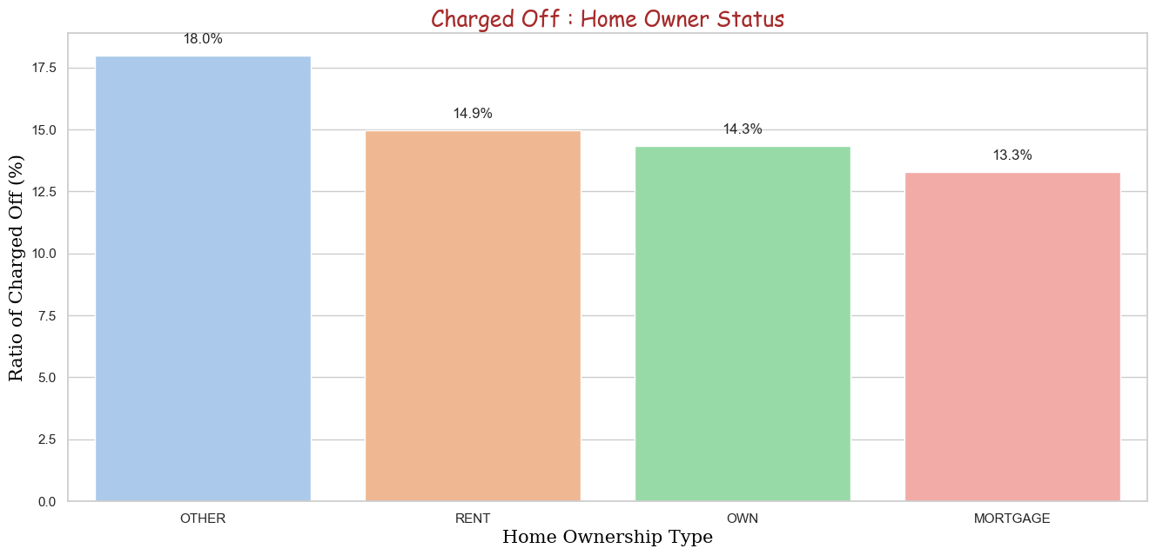
Within each Home Owner Status the ratio of OTHER is higher.
Other percent which is 18.0% highest.

Slide 34
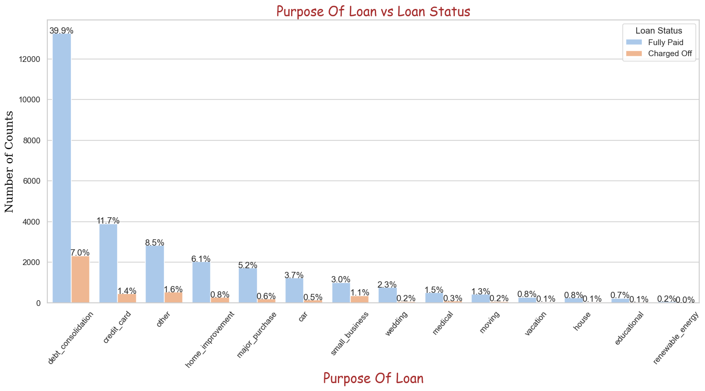
The category of deb_consolidation has the more risk of Charged Off.

Slide 35
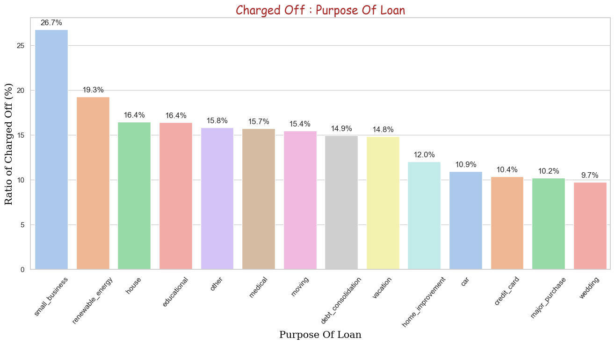
Highest probability of Charged Off within the category are small_business but the volume is immensely low.

Slide 36
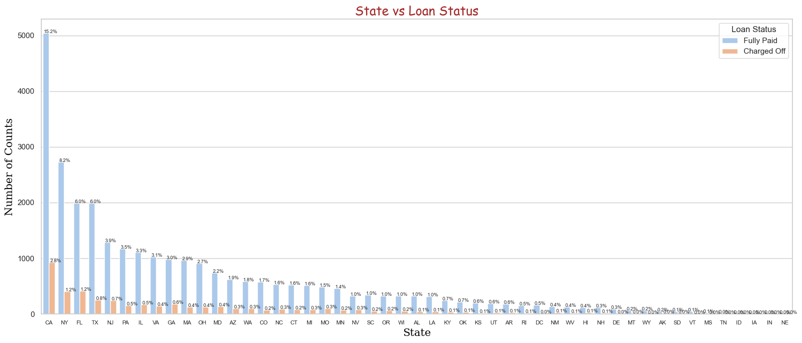
Highest Volume of Loans are from CA only.

Slide 37
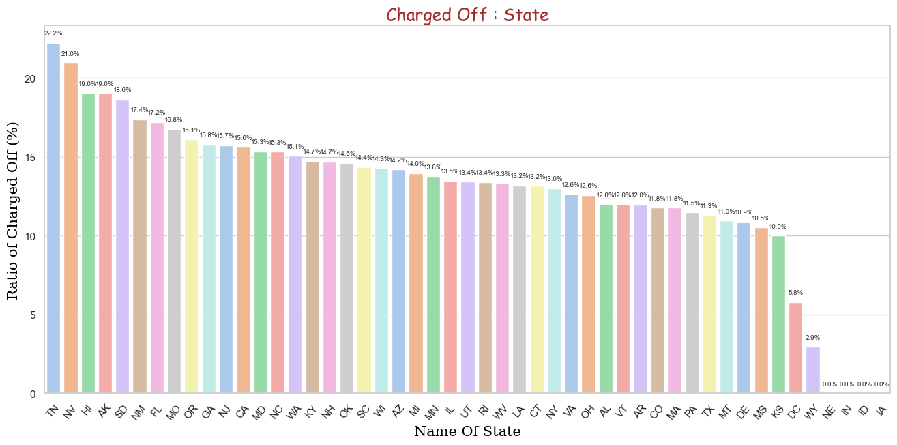
State TN and NV has the highest Charged Off.
NE, IN, ID, and IA are the very low volume which cannot be considered.
Loan applications from TN and NV will have very high risk.

Slide 38
State TN and NV has the highest Charged Off.
NE, IN, ID, and IA are the very low volume which cannot be considered.
Loan applications from TN and NV will have very high risk.

Slide 39
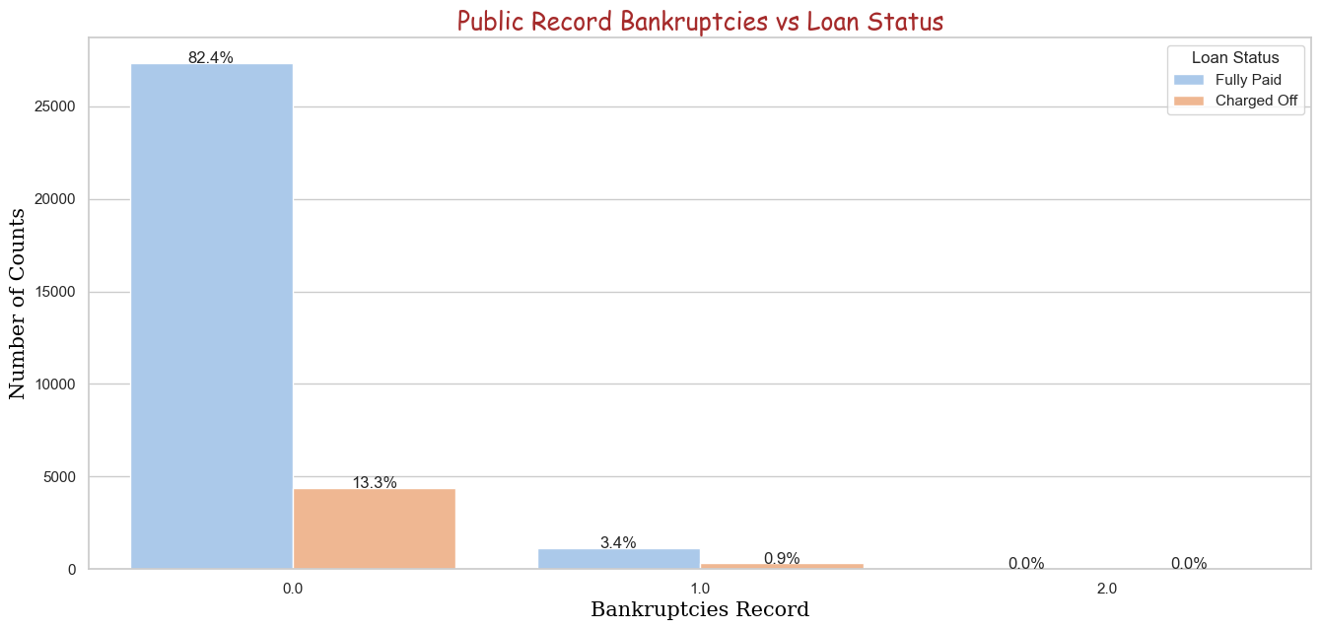
Higher number of Charged Off are in the category of 0.

Slide 40
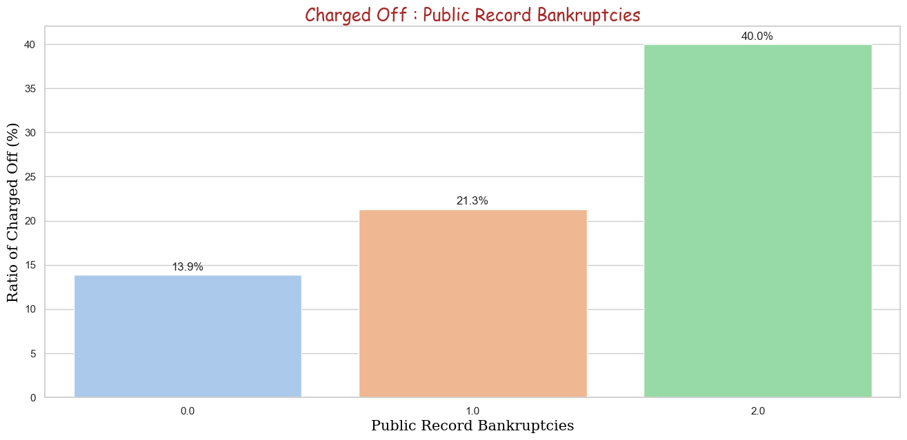
Customers having Bankruptcy record has high Charged Off ratio.

Slide 41
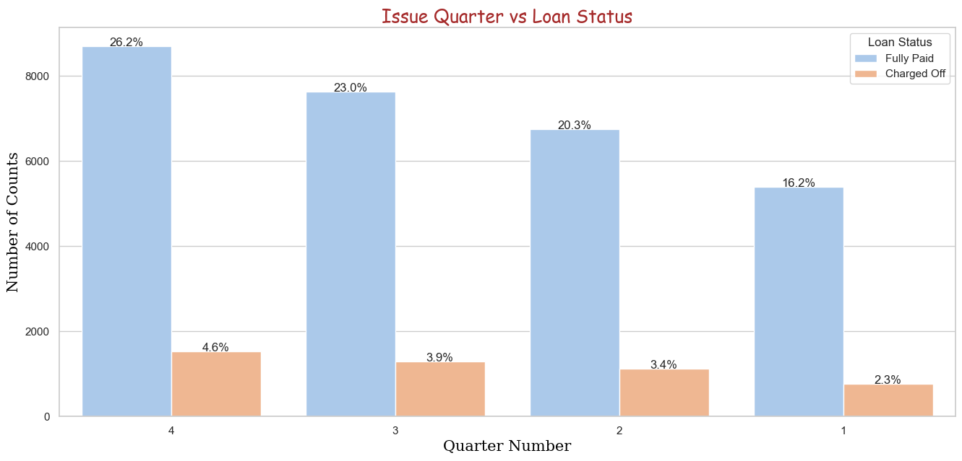
Quarter 4 has the maximum number of Loan Application.

Slide 42
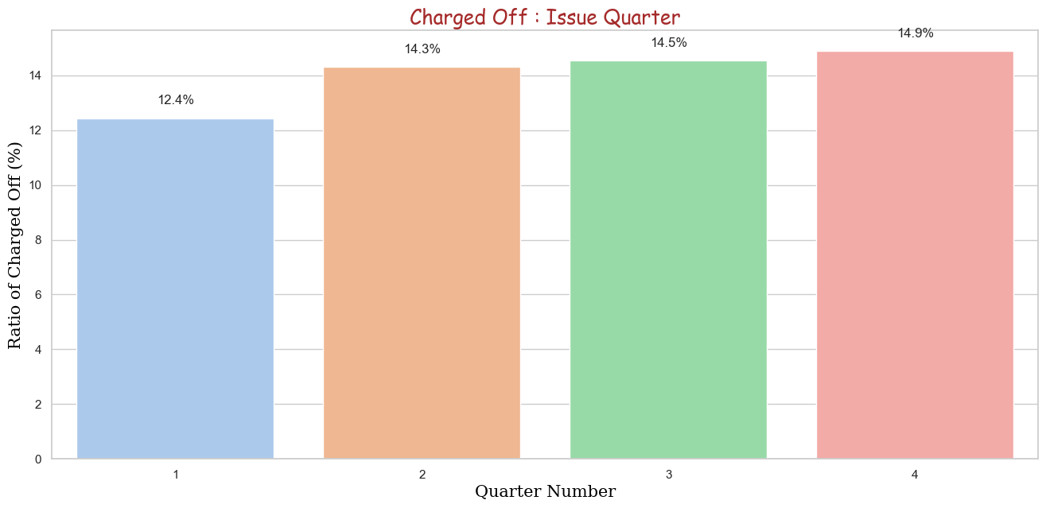
Quarter 4 has the highest ratio of Charged Off as compared to other three quarter.

Slide 43
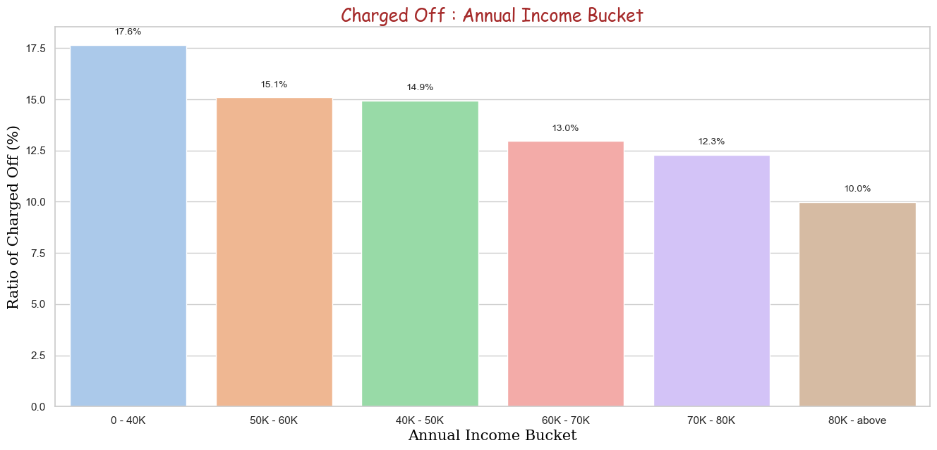
0-40K has the highest Charged Off of Annual Income Bucket and Ratio within the bucket as well.

Slide 44
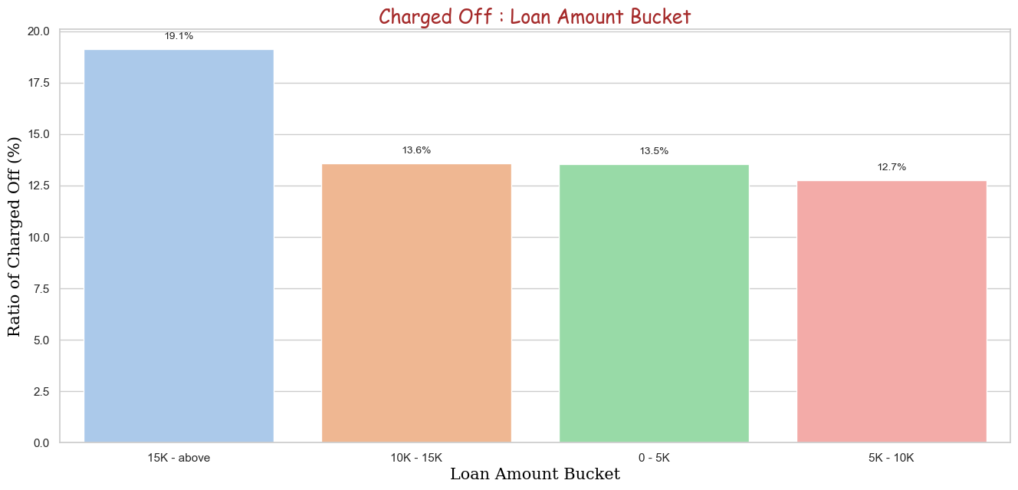
0-40K has the highest Charged Off of Annual Income Bucket and Ratio within the bucket as well.
The Charged Off Ratio of all the custormers within the Loan Amount Bucket of 15K-above is at the highest Charged Off.

Slide 45
0-40K has the highest Charged Off of Annual Income Bucket and Ratio within the bucket as well.

Slide 46
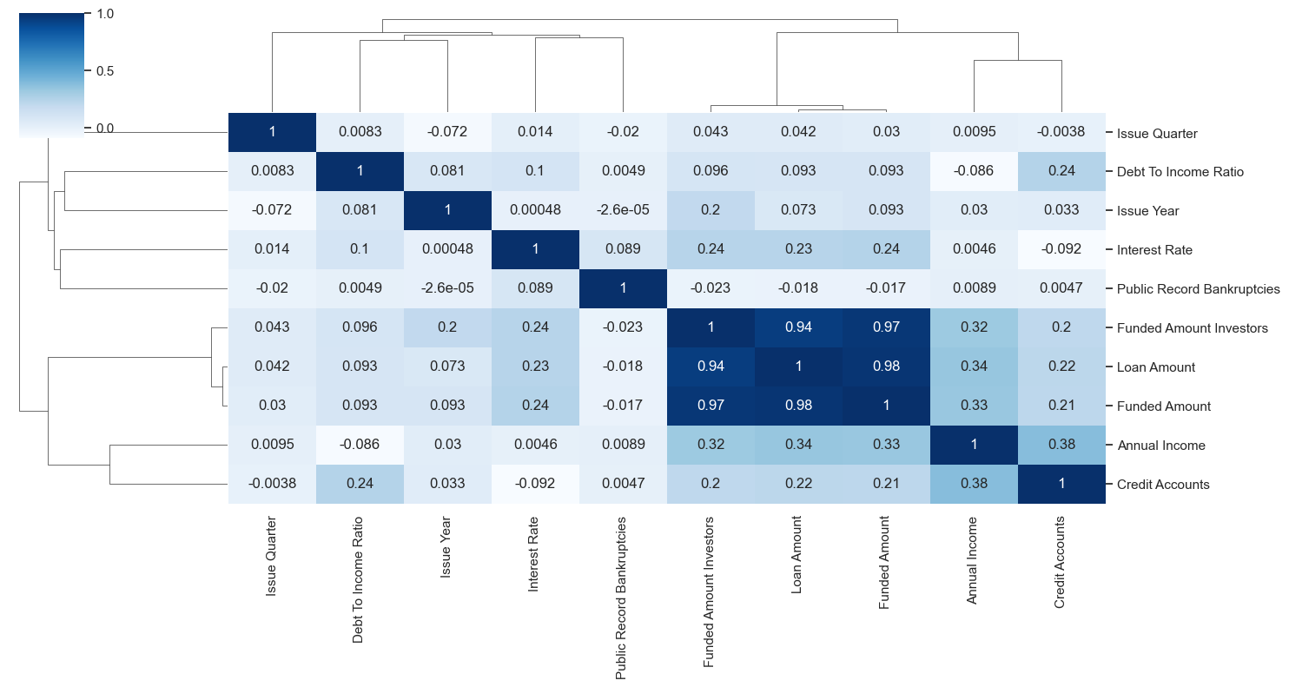

Slide 47
Negative Correlation
Loan Amount has negative correlation with Public Record Bankruptcies.
Annual Income has negative correlation with Debt To Income Ratio.
Strong Correlation
Term has strong correlation with Loan Amount.
Term has strong correlation with Interest Rate.
Annual Income has strong correlation with Loan Amount.
Weak Correlation
Public Record Bankruptcies has weak correlation with maximum number of fields.

